Slide 1
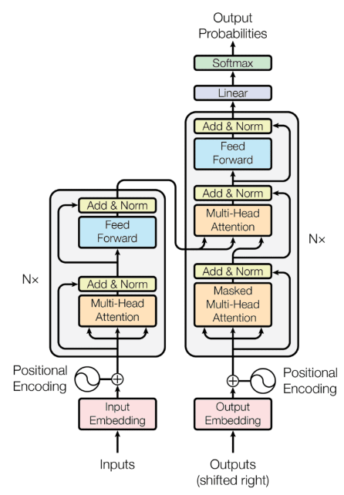
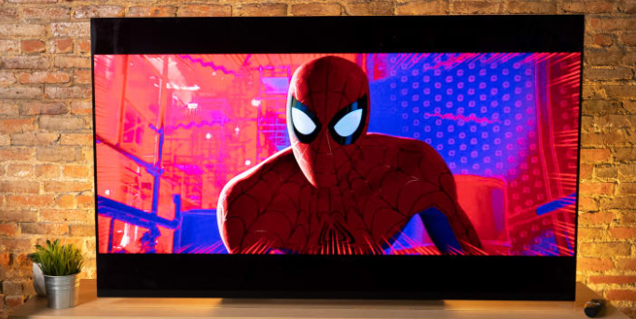
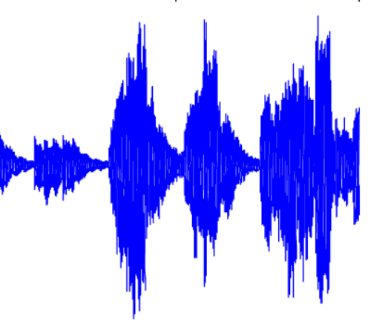
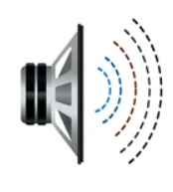
Character Features
Age
Gender
Role(villain, hero) Emotions(Emotional, Angry, Soft) etc.
Embedding Generator for text based characteristics
Transformer based Architecture for audio generation
Audio features (Based on current audio)
Pitch
Speech rate
Loudness etc.
Embedding Generator for Audio based characteristics
Output Audio
I am spiderman….
मैं स्पाइडरमैन हूं….
Current audio in English
Complex Feature Extraction (for surrounding sounds))
Embedding generator
Hindi Subtitles
Word Embedding generator

